Slide 1
Scalability in Graphics Programming
Liam Tyler
Notes:
Tie this back to HW4. What ill be talking about today, is how to take their HW4 to the next level

Slide 2
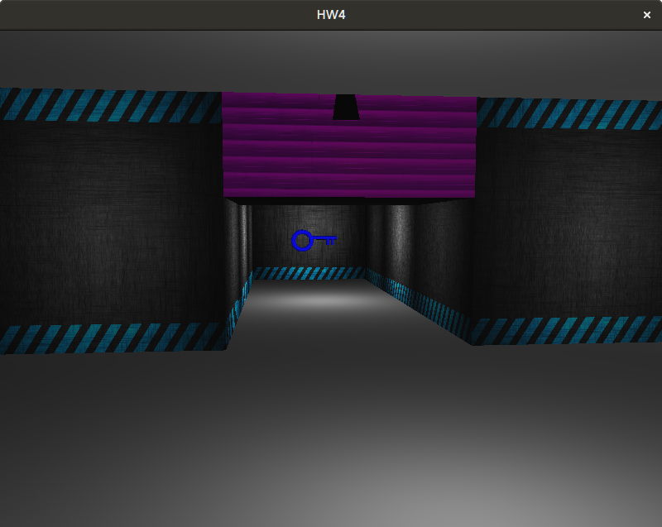

Main Question
?

Slide 3
Some Issues You Will Run Into
How do you render complex scenes and stay at 60 FPS?
How do you design your code to help you once you have large and complex games?
How do you represent and load tons of characters, environments, etc?
Notes:
Compare this all to HW4, and talk about scaling that up to be bigger (like a AAA game)

Slide 4
Topics
How do you render complex scenes and stay at 60 FPS?
How do you design your code to help you once you have large and complex games?
How do you represent and load tons of characters, environments, etc?
Rendering pipelines
Entity Component Systems
Resource management and optimization
Notes:
Talk about “The main question is though, why doesnt the way youre rendering in HW4 scale well?”

Slide 5
Forward Demo
Notes:
Do robot demo with forward
Do bouncing lights 100 + 1000 with forward
Ask WHY this happens as a transition to the next slide

Slide 6
Forward Rendering Review
Object / Geometry
Vertex Shader
Fragment Shader
Screen
What’s the most expensive thing here?
Notes:
Vertex shader figures out where the vertices appear on the screen
Fragment shader figures out what color each fragment/pixel is according to the material and lights

Slide 7
Forward Rendering Review
Object / Geometry
Vertex Shader
Fragment Shader
Screen
Lighting
For each light: Do blinn-phong (or other lighting model)
Notes:
This only gets worse if you’re doing a more complicated lighting model

Slide 8
Any Wasted Lighting Calculations?
Frustum
Eye
3
2
4
1

Slide 9
Any Wasted Lighting Calculations?
Frustum
Eye
All of the calculations done to figure out the color of boxes 1, 2, and 3 was wasted
3
2
4
1

Slide 10
Any Wasted Lighting Calculations?
O(num_fragments * num_lights)
Num_fragments includes the ones that never make it into the final image for that frame
You only have 16ms to do all of this, plus physics, animation, audio, etc…
Not enough time to deal with the waste

Slide 11
How Do We Get Rid of this Waste?
You’re always going to have overdraw
Is there a way to not light the occluded pixels?

Slide 12
Deferred Rendering
In the fragment shader, save all of the information needed for doing the lighting, but don’t actually do it yet
Once everything has been drawn to the screen, then go do the lighting
Prevents you from lighting fragments that end up getting overwritten

Slide 13
Deferred Rendering
What is needed to do lighting?
Position
Normal
Diffuse color
Specular color + exponent
Save this information into textures (collectively called the GBuffer)

Slide 14
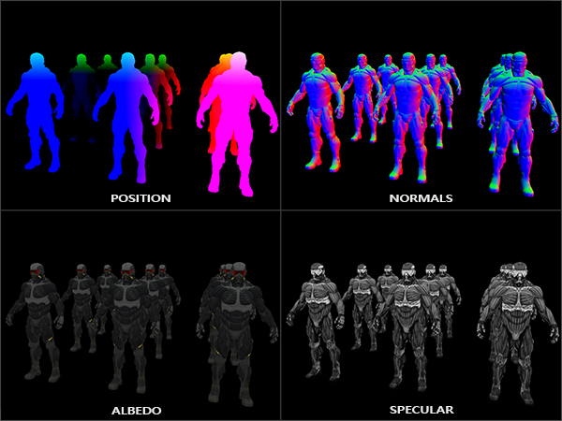
Deferred Rendering

Slide 15
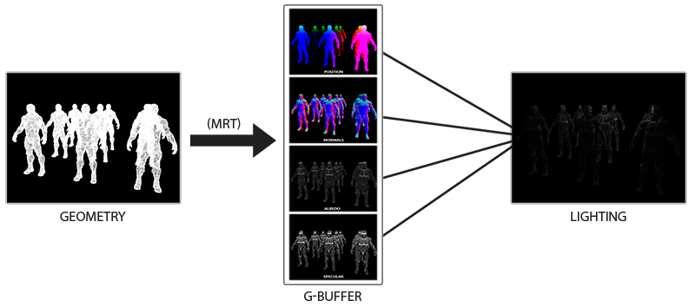
Deferred Rendering

Slide 16
Deferred Rendering Demo

Slide 17
Deferred Rendering Steps
Create a framebuffer (GBuffer)
Create and attach your 4 textures to it (be careful texture types here)
Bind the GBuffer
Draw your scene
Switch back to the screen buffer
Bind the textures to a shader
Draw a full screen quad
Do the lighting in the fragment shader for the quad

Slide 18
Deferred Rendering Disadvantages
Storage
Each texture has to be the size of the screen, most as floating point textures
More complicated lighting means more textures
Ex: 4K screen -> Each floating point texture is 128MB
Transparencies
Each fragment only has one value saved into the GBuffer
Overhead
Setup + texture access costs
For small scenes / low number of lights, might be worse than forward
Anti Aliasing
Hardware can’t do interpolation between colors of fragments
Notes:
Mention the memory cost as prohibitive on mobile devices
If you have many different kinds of materials, the size will be a bigger factor

Slide 19
Deferred Rendering
Great, it’s faster
O(num_fragments * num_lights) -> O(screen_res * num_lights)
Arguably not fast enough to be worth it:
Wasn’t that much faster
All of the downsides mentioned last slide
Many solutions around these
FPS scales better, but still linear with the number of lights
How might we do better?

Slide 20


Any Wasted Lighting Calculations?
Screen

Slide 21
Any Wasted Lighting Calculations?
Screen

Slide 22
Light Volumes - The Real Reason to do Deferred Rendering
Main idea: if you’re standing super far away from a point light, does it really affect you?
Yes, but not perceptibly
Identify the effective range of a light
Identify some cutoff intensity (ex: 0.03)
Use your lighting attenuation equation, and solve
Intensity = I / d^2 -> 0.03 = I / d^2
Only affect the pixels inside this radius for each light
How do we actually identify those pixels?

Slide 23
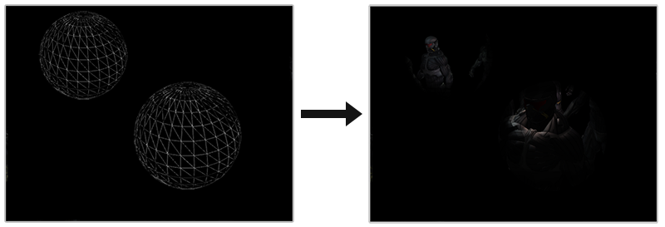
Light Volumes
Render an actual sphere with the radius calculated in the last step

Slide 24
Any Wasted Lighting Calculations?
Screen

Slide 25
Light Volumes Demo

Slide 26
Light Volume Steps
Same thing as deferred rendering until drawing the quad
Instead: turn on additive blending, turn off depth writing and testing
For each light:
Pass the light’s color and position to the shader
Render an actual sphere with the position and radius of the point light
In the fragment shader, find out how much color this one light adds
Notes:
Ask the audience: what would you do for a directional light?

Slide 27
Light Volumes Limitations
Can be expensive to render tons of spheres
Use simpler geometry
Fragment depth ignored
Super bright lights kind of ruin this
Tons of texture accesses
So… Again, can we do better?

Slide 28
Tiled Deferred Rendering Demo
Notes:
Mention this is what that first demo uses

Slide 29
Tiled Deferred Rendering
Main idea: Identify the pixels that are affected, but don’t do so many texture accesses

Slide 30
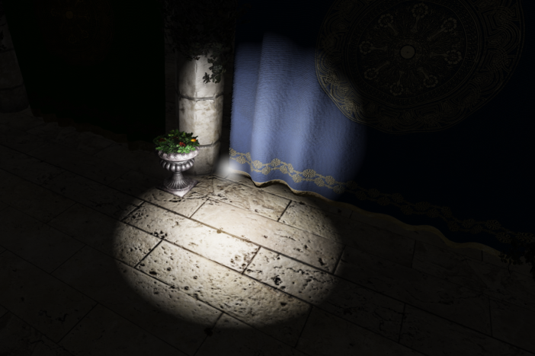
Tiled Deferred Rendering
Notes:
Example: say this is our scene

Slide 31
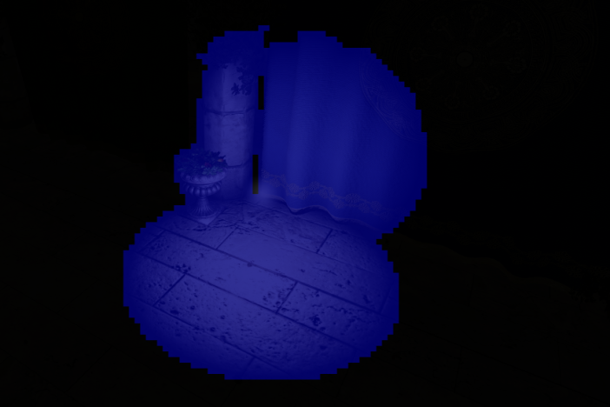
Tiled Deferred Rendering
Notes:
Break the screen up into tiles (16 x 16 pixels)
Identify which tiles this light affects

Slide 32
Tiled Deferred Rendering
Run a compute shader on each tile
For each tile, make a list of lights that hit that tile
Access the textures once, and then loop through that list of lights we made

Slide 33
Other Rendering Pipelines
Forward+
Clustered
Tiled rendering (one tile at a time)

Slide 34

But really….
Notes:
Talk about how you almost never have a scene with so many lights
Forward rendering gets you super far
Only like 2 games ago did the CoD engine switch to deferred

Slide 35
Topics
How do you render complex scenes and stay at 60 FPS?
How do you design your code to help you once you have large and complex games?
How do you represent and load tons of characters, environments, etc?
Rendering pipelines
Entity Component Systems
Resource management and optimization

Slide 36
How Would You Scale Up HW4?
Most of you are probably currently doing an ad hoc approach to representing objects in your scene
How well would this work for huge games?
What other options are there?
First idea: Inheritance
Notes:
When i say scale up, i mean: How would you represent new objects? Golems, cars, clouds, etc
How do you organize their data and logic?
How would you share common functionality?

Slide 37
Inheritance Based Model
GameObject
Animatable
Static
Destructible
Enemy
Player
House

Slide 38


Inheritance Based Model Example
Notes:
Godot isnt strictly inheritance based, they also kind of have ECS
Why are there no AAA games with Godot?

Slide 39
Inheritance Based Model
GameObject
Animatable
Static
Destructible
Enemy
Player
House
Destructible Robot
Notes:
“You wanted a banana but what you got was a gorilla holding the banana and the entire jungle”

Slide 40
Inheritance Based Model - The Blob
GameObject
Animatable
Static
Destructible
Enemy
Player
House
Destructible Robot
Notes:
Blob class
Really high coupling, hard to manage, hard to sit down and design

Slide 41
Entities & Components
Different way to design your objects
Provides greater flexibility when defining objects
Uses composition over inheritance

Slide 42
Example
MeshRenderer Component
(Player)
Physics Component
Entity/
GameObject
Input Component
Notes:
A game object is now defined by what components its made up of

Slide 43
Example
MeshRenderer Component
(Enemy)
Physics Component
Entity/
GameObject
Lootable Component
Health Regeneration Component
Notes:
To create new gameobjects, you can reuse old components, or add new ones to help define that object
Talk about composition
All of your objects base and final types are GameObject, you just add components too them

Slide 44

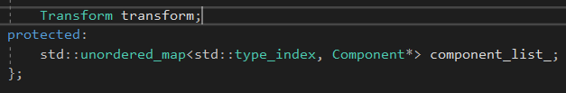
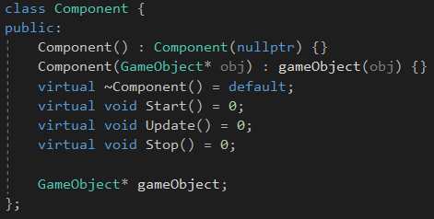
Code Example

Slide 45
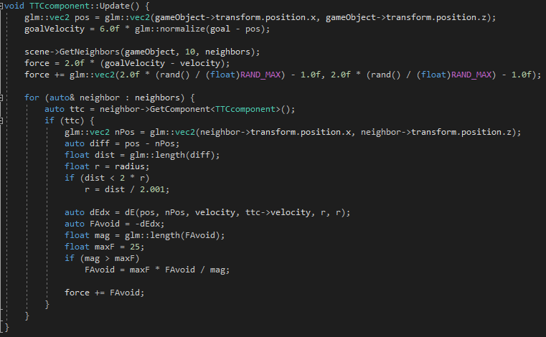
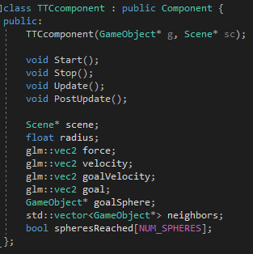
Code Example

Slide 46
Advantages
Way easier to create new types of objects
Easy to create new components too
Much more manageable
Easier to update components without breaking everything
Composition at runtime

Slide 47
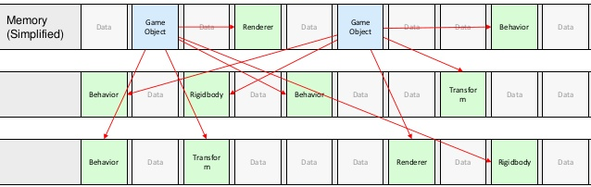
Problems
Notes:
Data is scattered
Lots of cache misses
Virtual calls

Slide 48
Entity Component Systems (ECS)
Separating the data from the logic
Entities (collection of components)
Components (data only)
Systems (logic only)

Slide 49
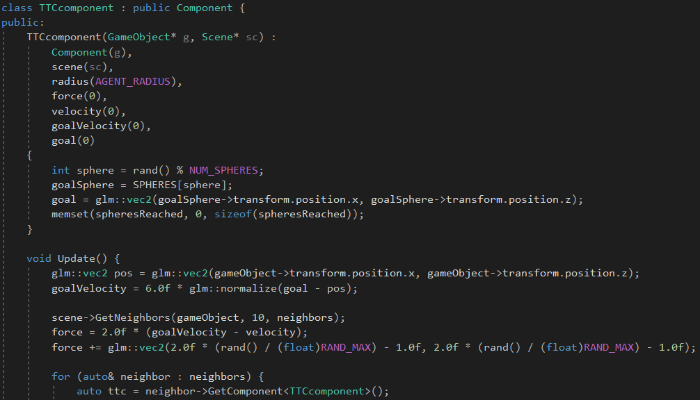
ECS Violation
The component has both data (velocity, radius, etc) and logic (the update function) in it
Notes:
The point here is that the data and logic are together
Go back to the MeshRenderer slide to show what Pure ECS looks like

Slide 50
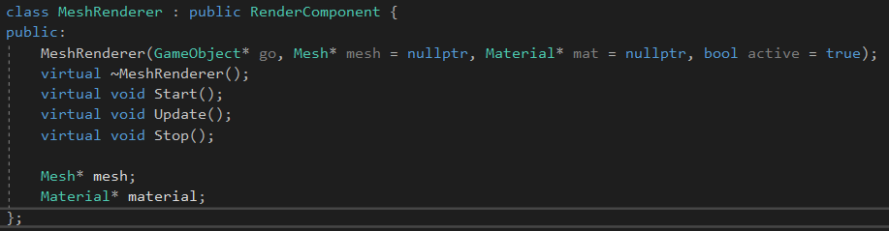
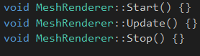
ECS Example
Header file
Cpp file

Slide 51
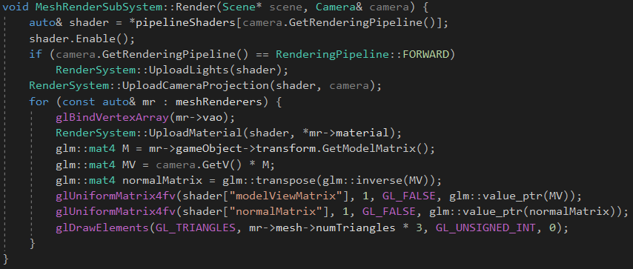
ECS Example
Notes:
An outside system (MeshRenderSubSystem) loops over all of the components, and performs all of the logic

Slide 52
ECS Advantages
Better performance than just entities + components
Data driven design
More readable and modular
Notes:
Cache is king
Talk about the nomenclature online, how both are ECS, ‘classic’ vs ‘pure’

Slide 53
Topics
How do you render complex scenes and stay at 60 FPS?
How do you design your code to help you once you have large and complex games?
How do you represent and load tons of characters, environments, etc?
Rendering pipelines
Entity Component Systems
Resource management and optimization

Slide 54
Resource Management
What is it? Loading and managing game content
Example: In HW4 you had to load a scene, models, textures, etc
Resource management plays a huge roll in how flexible, and how fast your game engine is

Slide 55

Resource Management
Speed:
How fast you load resources is really important
Notes:
Sonic 06’. Also known as the game of loading screens. 39 seconds to load the overworld, which you’re in for 10 seconds to start a mission

Slide 56
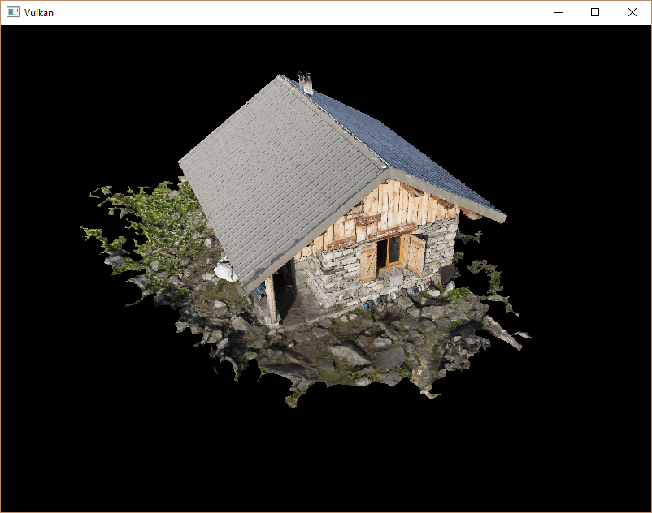
Resource Management Optimization
My scenario: The house
Notes:
Give a note that none of the things I’m about to show are very complicated. Just simple things that made a big impact

Slide 57
Resource Management Optimization
OBJ size: 48 MB
Texture size: 2.9 MB (4K)
Triangles: ½ million
Model load time: 1.487s
Texture load time: 0.6s
Model size on GPU: 51.5 MB

Slide 58
Removing Duplicate Vertices
Model size on GPU: 51.5 MB -> 13.8 MB
Model load time: 1.487s -> 1.710s
Time: 15% increase
Memory: 73% decrease
Notes:
Memory usage on the GPU is nearly 1/4th of the size

Slide 59
Creating Custom File Format
3 vertices from OBJ file:
v -0.653835 -0.167991 0.786276
v -0.614223 -0.144022 0.793519
v -0.585095 -0.226753 0.799376
93 characters, which means it takes 93 bytes to represent 3 vertices
Once loaded though: (3 verts)*(3 floats per vert) * (4 bytes per float) = 36 bytes
Just dump the mesh data into a binary file directly
Loading it won’t need any processing then
Notes:
Inheritely, text files are going to be a much less compact representation of the data

Slide 60
Custom File Format
Model size on disk: 51.5 MB -> 14.2 MB
Model load Time: 1.487s -> 1.710s -> 0.058s
Time: 96% decrease
Memory: 73% decrease
Notes:
Note that the theoretical time for loading 14.2 MB from my 550MB / s SSD hard drive is 26ms, but i still need to allocate arrays on CPU, copy to GPU, etc

Slide 61
In Total
Model load Time: 0.058s
Texture load time: 0.6 seconds
Why???

Slide 62
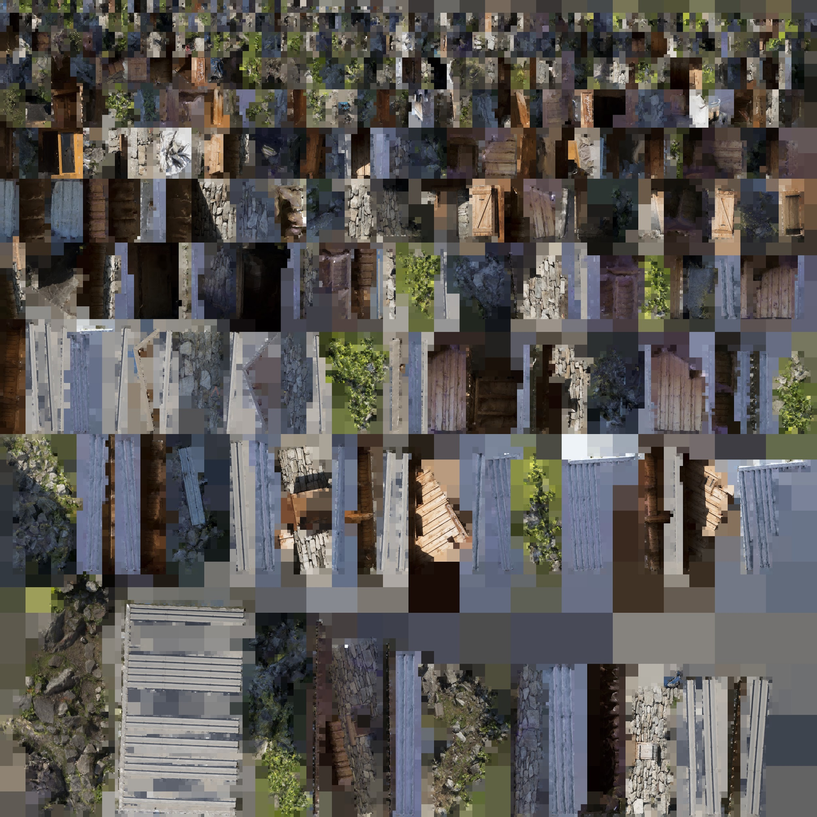
Texture Loading
Floats suck
From HW1, floats were easier to work with
But for almost every other scenario, do you actually need floats?
Converting to them is slow, and it uses 4 times as much memory

Slide 63
Texture Loading
Just take the output of stb_image directly (as unsigned chars)
Time: 0.6s -> 0.18s
Memory: 192MB -> 48MB (1/4th as much)
Notes:
Mention that the texture has has 3 components, RGB (no A)

Slide 64
Final Results
Model size on disk: 48 MB -> 14.2 MB
Model load time: 1.487s -> 0.058s
Model GPU size: 51.5 MB -> 13.8 MB
Texture load time: 0.6s -> 0.18s
Texture GPU size: 192 MB -> 48 MB
Disk size: (48 + 2.9) -> (14.2 + 2.9) == 64% decrease
Total time: 2.087s -> 0.238s == 89% decrease
GPU memory: 243.5 MB -> 61.8 MB == 75% decrease

Slide 65
Could We Do Better?
Compressed files
Memory mapping
Custom image format
Notes:
Talk about how the compressed files are becoming less and less of a need nowadays
Disk speed -> 75MB -> 550MB -> 3500MB

Slide 66
Final Comments
If you go write your own game engine (which you should):
DON’T:
Get stuck with ‘analysis paralysis’
Worry much about efficiency
DO:
Write the inefficient thing, and tack on a ‘TODO’ for later
Create the minimum viable product
Use EC or ECS

Slide 67

Have a Good Thanksgiving!

